Slide 1
MMA 801 Introduction to Management
Session 2 a) Strategy Revisited
b) Business Model Analysis, Development & Reframing
c) Roku Case

Slide 3
MMA 801 Session 2 Outline
1. Lecture/discussion
a) Strategy revisited | 30 minutes
b) Business models | 30 minutes
2. Exercise #2: Business model analysis
a) Breakout room activity | 90 minutes
b) Presentations | 30 minutes
3. Debrief | 25 minutes
4. Preparation for session 3 | 5 minutes

Slide 4
Societal Forces
Visually, think of the Strategic Planning challenge and response in the following manner
Macro-Economic Forces
Industry Forces
Market Forces
Company
Current Business System and Model
Profitability and Growth Outcomes
Business System and Model Evaluation
Company is defined by an underlying
Structure
Culture
Resources
Talent Pool
Product/ Service Portfolio
Way of Doing Business
Company – Constraint Triangle
Maintain
Build Upon
Rejuvenate
Reinvent
Adjustments to the way we do business
Cultural Forces
Mgmt. Decision Legacy

Slide 5
MMA 801 Strategy and Business Models
Execution Test
What we want to do
How we want to do it
Strategic Priorities
Critical or Core Activities
(Key Pivots)
MATCH
Defines where you will focus your resources (capital, talent, time, resources, physical assets, etc.) in order to be successful.

Slide 6
MMA 801 What is a Business Model?
A company's architectural platform for pursuing its strategy. It reflects the company's belief as to how value is created and delivered. It is the summation of the core business decisions and trade-offs employed to earn a profit. It takes into consideration five fundamentals…
These elements (the system) interact in consistent and complementary ways. A change to one, will impact the others.
Business Model Composition
Culture, Structure & Mgmt. Systems
Customer Value Proposition
(Effective, Reliable, Affordable, Convenient Solutions)
Critical Resources
(People, Assets, Capital, Technology, Brand)
Critical Processes
(Repeatable, Scalable, Sustainable)
Profit Formula
(Revenue Model, Cost Structure, Target Margins, Resource Velocity)

Slide 7
Building Blocks
Company-Centric Analysis
Market-Centric Analysis Analysis
Building Blocks of Your Execution Hypothesis
Key Partners
(Backward, Forward & ecosystem dependencies)
Key Activities
(Value Chain)
Portfolio of Products & Services
Positioning
Available Customer Segments
(Primary & secondary, size, penetration potential)
Value Proposition
Key Resources
(Composition & velocity)
Customer Relationships
Opportunity Assessment
Market Logic
Underlying Cost Model
(Cost structure & drivers,
scale potential, BEP, etc., capitalization requirements, COC)
Revenue Model
(volume, scope, purchase frequency, sales augmentation, COC, capitalization consumption, ASP degradation)
Culture, Structure & Mgmt. Systems
Adapted from: Business Model Generation, Osterwalder, Pigneur
Notes:
Does your current structure still make sense? Heat map it…where do the key "value" points reside?....Think in terms of maintain, enhance, reduce or remove.

Slide 8
MMA 801 Company-Centric Side
MIS, IT, HRM, Fin & Acct., Legal, Admin
Value Chain Analysis – Looking for critical linchpins
R&D
(Engineering)
Inbound Logistics
Transformative
Processes
Outbound Logistics
Marketing
Key Partners
Supply, Transformation, Distribution, Sales & Service
Process Management
Partner Management
Product Management
Operational Analytics
Sourcing
Material Procurement
JIT Inventory Management
Quality Assurance
Dependability
VMI – Vendor-Managed Inventory Arrangements
Facility Design & Layout
Process Design & Layout
Process Management
Materials Management
Quality Assurance
Warehouse & ICC Management
Transportation Management
Marketing Process Management
Sales Forecasting
Sales Management
Customer Service Management
Adapted From: Porter's Value Chain

Slide 9
MMA 801 Market-Centric Logic
Target Market
Customer Need
Solution Fit
Key Value Delivered
What drives the P/Q relationship?
Competitor Identification
Uniqueness or Differentiation
Why What We Do Works
What Makes it Difficult to Imitate?
Do we have advantage? Is it being leveraged?
Basis of Competitive Advantage

Slide 10
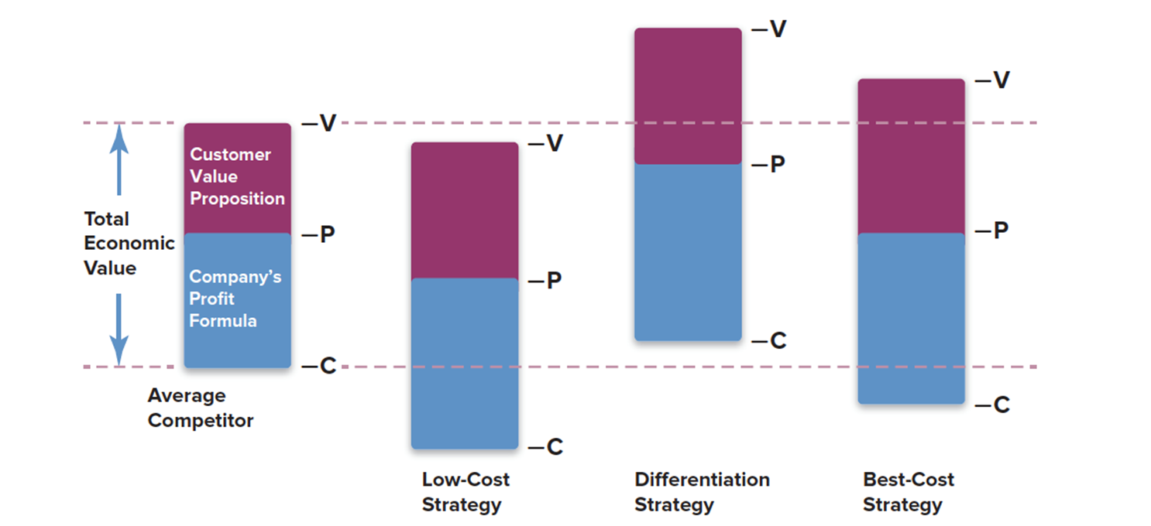
MMA 801 Strategy & SCA Revisited
Competitive Advantage is driven by two fundamental outcomes
Creation of "Willingness to Pay", resulting in enhanced margin
Efficiencies resulting in "lower cost base", thereby enhancing margin
Combination of the two
Image from Thompson, Crafting and Executing Strategy

Slide 11
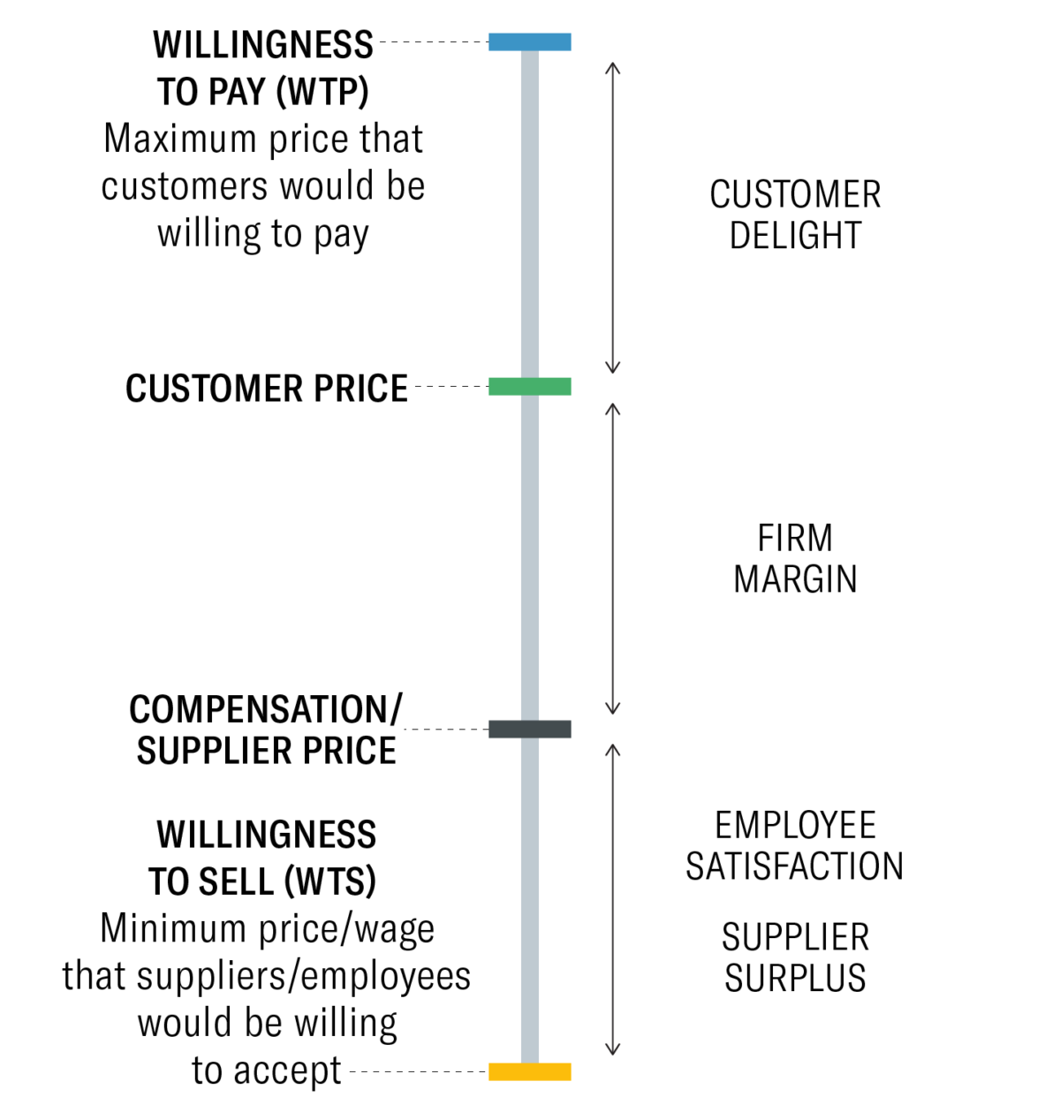
Strategy and Value
Strategy & Value
A Value Proposition Template
For ____________ (target customer)
who ____________ (statement of the need or opportunity), our (product/service name) is ____________ (product category)
that (statement of benefit) ____________ .
Adapted from Geoffrey Moore’s Crossing The Chasm: Marketing and Selling Disruptive Products to Mainstream Customers (Harper Collins, 2002).
Graphic from https://hbr.org/2021/05/eliminate-strategic-overload

Slide 12
MMA 801 Competitive Advantage – Sources
Management Systems
- Portfolio Management
- M&As, Alliances, etc.
- Business Unit Strategies
- Talent Relationships
- Culture
Proprietary Assets
- Tangible Assets
- Scale
- Technology
- Brand
- Locked-in Customer Networks
Operating Capabilities
- Supply Chain Logistics
- Production & Operations
- "Go-to Market" Capabilities
- Customer Relationships
- Privileged Insight

Slide 13
MMA 801 Business Model & SCA
What increases the staying power of a business model and drives advantage?
Creates customer stickiness or loyalty
Embeds your processes into your client's core activities
Leverages barriers to entry
Continuously invents a portfolio of opportunities
Avoids the influence of capital market short-termism

Slide 14
MMAI 801 – Session 2 Revisit
MMA 801 Critically Assessing Your Model
Activity Mapping
Agility Metering
Degree of lock-in and asset heaviness
Reflects degree of disruption risk and embedded inertia exposure
Reflects balance between agility and resiliency
Ties strategy to business model structure and design/redesign
Defines activities to drive execution

Slide 15
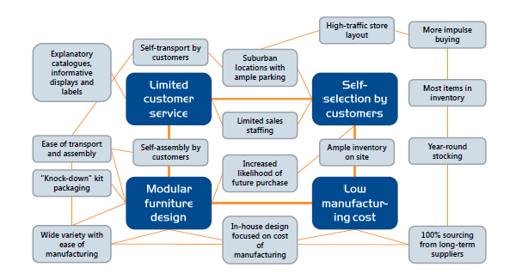
MMA 801 Activity Mapping
Identify core competencies
Map clusters of activities and processes that support the core competencies
Isolate clusters where pivot may be required
Activity Map for IKEA
Adapted from https://www.b2binternational.com/publications/differentiation/

Slide 16
MMA 801 Business Model Lock-In
Agility
Business Model Lock-in
Resilience
Business Model Lock-in defines the underlying rigidity of the business model, with respect to its ability to pivot in response to market shifts
Capital Capacity
Level of Fixed Tangible Asset Dependency
Degree of Process and System Standardization
Degree of Product Standardization
Committed Project Timeframes
Degree of Innovation Incubation
Degree of Existing Customer Dependency

Slide 17
MMA 801 Business Models – Logic Test
Value Logic
Matching Product/Services to Customer Needs
Market Logic
Demand Creation to Revenue Conversion – are the mechanics in place?
Business Logic
Strategic Initiatives and Outcomes…matched to capabilities
Value Creation Logic
Resources & Processes – can we deliver?
Risk Logic
Degree of risk shift and potential exposure
Business models reflect 5 "Logical Conclusions" relating to how to compete:

Slide 18

MMA 801 Broader Lens
The Broader Lens – Networks & Ecosystem Relationships
Who else needs to innovate and execute for our company to be successful?
External
Ecosystem Co-innovation
Dependencies
Recognize Network Co-Dependencies Fundamental to Success
What does it take to deliver on time, on spec, and beat the competition?
Internal Ecosystem Competencies
External Ecosystem Adoption Dependencies
Google Home – Chromecast Compatible
Electric Vehicle Manufacturers – Battery Manufacturers
Canada Goose – Retailers
Video Streamers & Theatres – Content Producers
Airbus – Engine Manufacturers
Who else needs to adopt our products/services before the end customer can assess the full value proposition?

Slide 19
Business Model Disruption
Company-Centric Analysis
Market-Centric Analysis Analysis
Disruptors and derailers
Degree of lock-in - Asset driven
Ecosystem disconnect
Lack of capabilities and competencies
Positioning
Available Customer Segments
(Primary & secondary, size, penetration potential)
Key Partners
(Backward, Forward & ecosystem dependencies)
Key Activities
(Value Chain)
Portfolio of Products & Services
Imitation
Substitutability
Shift in consumer needs
Marketing inertia
Value Proposition
Hold up – bargaining power shift…buyers, suppliers, complementors
Value curve shifts
Price sensitivity
Market reshaping
Key Resources
(Composition & velocity)
Customer Relationships
Capital, asset, talent constraints
Opportunity Assessment
Shifts in economies of scale and scope
Pricing dynamics
Market Logic
Cost bloating
Expense creep
Margin erosion
Lack of scope and scale
Underlying Cost Model
(Cost structure & drivers,
scale potential, BEP, etc., capitalization requirements, COC)
Revenue Model
(volume, scope, purchase frequency, sales augmentation, COC, capitalization consumption, ASP degradation)
Managerial & organizational mind-set (active inertia)
Culture, Structure & Mgmt. Systems
Adapted from: Business Model Generation, Osterwalder, Pigneur
Notes:
Does your current structure still make sense? Heat map it…where do the key "value" points reside?....Think in terms of maintain, enhance, reduce or remove.

Slide 20
MMA 801 Business Model Exposure
Industry/Sector Growth
Company Performance
Active Inertia (Glued to present business mechanics)
Market Inertia (Perceive market to be static)
Ignoring disrupters & solution simplification.
Letting outdated beliefs drive the value equation.
Believing that operational efficiencies improvement are the way to create future profit.
Emphasizing incremental and transactional innovations over transformative innovations.
Belief that the current interaction of technology, regulations and business economics will remain relevant going forward.
Limiting how far a project team can venture from traditional offerings.
Impatience for historical growth which result in passing slower, nurturing-required, innovations.
Adherence to the current profit model and its existing margins.
Failure to recognize that consumer behaviour is changing, causing shifts in demand.
Belief that the inclusion of customer loyalty programs (etc.) will remain primary to driving customer retention.
Failure to respond to customer notions that alternatives are increasingly attractive to them.
Viewing the market solely from your current customer base.

Slide 21
MMA 801 Type of Change Required
Core Conclusion of Your Strategic Discussions
Identification and Execution – Degree of Change
Level of Risk of Execution and Resistance
Paradigm
Cultural
Strategic
Operational
Degree of Required Pivot or Change
EKNResearch.com

Slide 22
Strategy Identification
Revenue Model
Profitability, Cash Flow, Volatility & Predictability
Asset Model
Asset Investment Requirements
Opportunity Identification
External Financing Requirements
Amount, Timing, Duration
Sensitivity Analysis – Stress Test
Achievable Operating Plan
Achievable Financing Plan
Your business model also reflects your risk exposure relating to the allocation and timing (deployment) of resources, and the degree of lock-in relating to asset development and operations.
Yes
Execute
Successful models match the composition of business system assets and resources with the revenue model, and continuously manage this relationship.

Slide 23
MMA 801 Reframing – Key Steps
Map out the dominant and/or emerging disruptive business model in the industry.
Define the underlying "core beliefs" which drive notions relating to customer interaction, technology, performance, operations, etc.
Turn this/these underlying belief(s) upside down. Reframe/change the belief pattern.
Sanity-test your new perceptions. Will they gain traction and acceptance.
Transfer the accepted reframe beliefs into your business model.
Adapted from: Disrupting Beliefs: A New Approach to Business Model Innovation, Jong and van Dijk, McKinsey Quarterly

Slide 24
MMA 801 Key Factors for Execution
The competencies required for success are known, exist, or obtainable within a realistic period of time.
The value proposition assists your customers in achieving a definitive solution which your competitors are unable to match.
Specific, measurable and definitive metrics (guiding principles) are implemented and adhered to as decisions evolve.
The model itself, becomes the anchor of competitive advantage. Successful companies know the underlying basis of their model's focus…accessibility, quality, wealth disruption, etc.,…heat map the related activities and processes, prioritize and allocate resources accordingly.

Slide 25




Business Model @ Disney
How we will deliver value!
Studio Entertainment
Activities: Produce music, movies and character content, brand management, acquisitions
Revenue Streams: Theatrical distribution, home entertainment (DVD/Blu-ray/e-format), TV/SVOD distribution (IP licensing fee, ticket sales from stage plays)
Parks, Experiences & Products
Activities: Park and resort construction, facility management, tourist activities
Revenue Streams: Theme park admissions, merchandise, food and beverage, resorts and vacations, merchandise licensing and retail sales, and park licensing (Tokyo Disney Resort)
How we will create & value!
Create
Studio Entertainment creates intellectual property by developing characters through compelling story telling
Distribute/Connect
Disney Studios and Media Distribution & Networks, along with Disney's DTC platform, share these stores with their audience.
Commercialize
Successful stories are commercialized through Disney's branded products. Additional revenue is made through the licensing right provided to manufacturers & distributors.
Media Networks
Activities: Content distribution, brand management, licensing, partnership with advertisers, TV, cable and theaters
Revenue Steams: Affiliate fees, Advertising, and TV/SVOD distribution
Direct-to-Consumer & International
Activities: Infrastructure development, advertising, content distribution, partnership/licensing, acquisitions
Revenue Streams: Subscription fees, advertising, affiliate fees, TV/SVOD distribution
Capitalize- Assets
Infrastructure is built for the characters and stories that generate the biggest commercial success. Attractions are built at the Disney theme parks to further capitalize on Disney brands.

